Slide 1
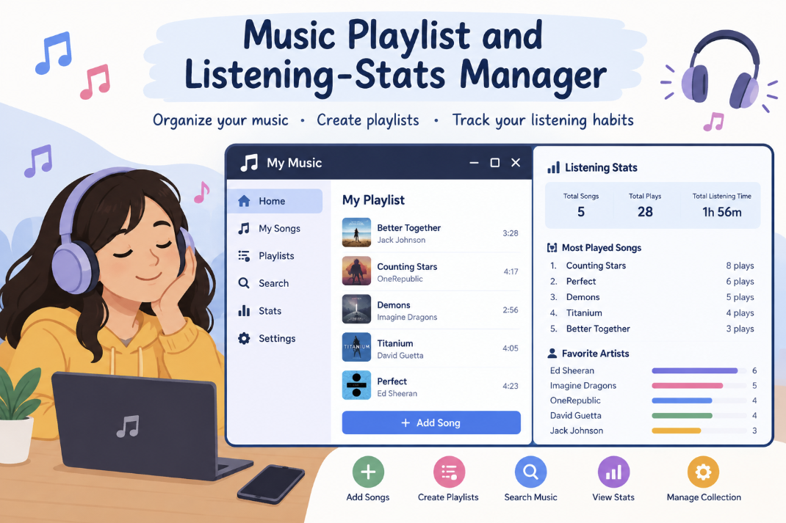

CAPSTONE PROJECT
Music Playlist & Listening
Stats Manager
2620030390 BARATAM SREEMAYI
2620030423 M. SAI CHARITA
SECTION - 2

Slide 2

Abstract
The Music Playlist and Listening-Stats Manager is a simple Java-based application used to manage songs and track listening habits. It allows users to add songs, store song details, display songs, and record the number of times each song is played. It provides an easy way to organise music and understand which songs are played the most. In the future, features like song search, favourites, sorting, multiple playlists, and a graphical interface can be added.

Slide 3
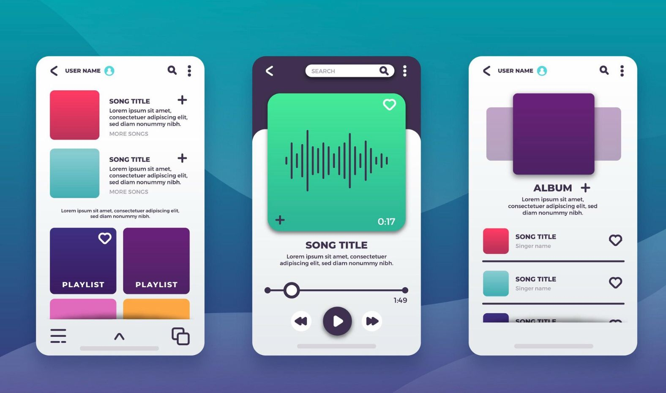
Introduction
What It Is
A simple Java-based application to manage songs and track listening habits with ease.
What It Does
Add songs, store song details, display your music collection, and count plays per song.
How It Works
Built using arrays, loops, conditions, switch statements, operators, and methods.
Where It Goes
Future scope includes song search, sorting, multiple playlists, favourites, and a GUI.

Slide 4
Course Outcomes Covered
CO1 — Data Types & Operators
CO2 — Control Structures
CO3 — Methods & Arrays
Conditions, loops, switch statements, and break are used to control program flow, handle user choices, and manage the interactive menu system.
Methods organize different operations such as adding and displaying songs, while arrays efficiently store and manage multiple song details in memory.
Data types and operators are used to store song details such as name, duration, and play count, and to perform calculations on listening statistics.

Slide 5
Course Outcomes Covered
CO4 — OOP & Exceptions
Song and Playlist classes with encapsulated fields, inheritance for song types, and try-catch for invalid input.
CO5— Strings & File I/O
String methods to search by title
or artist, Comparator to sort by
play count, and files to save
playlists.
CO6 — Collections &
Streams
ArrayList and HashMap to
store songs and play
counts, with Streams
to filter, sort, and group
listening stats.
.

Slide 6
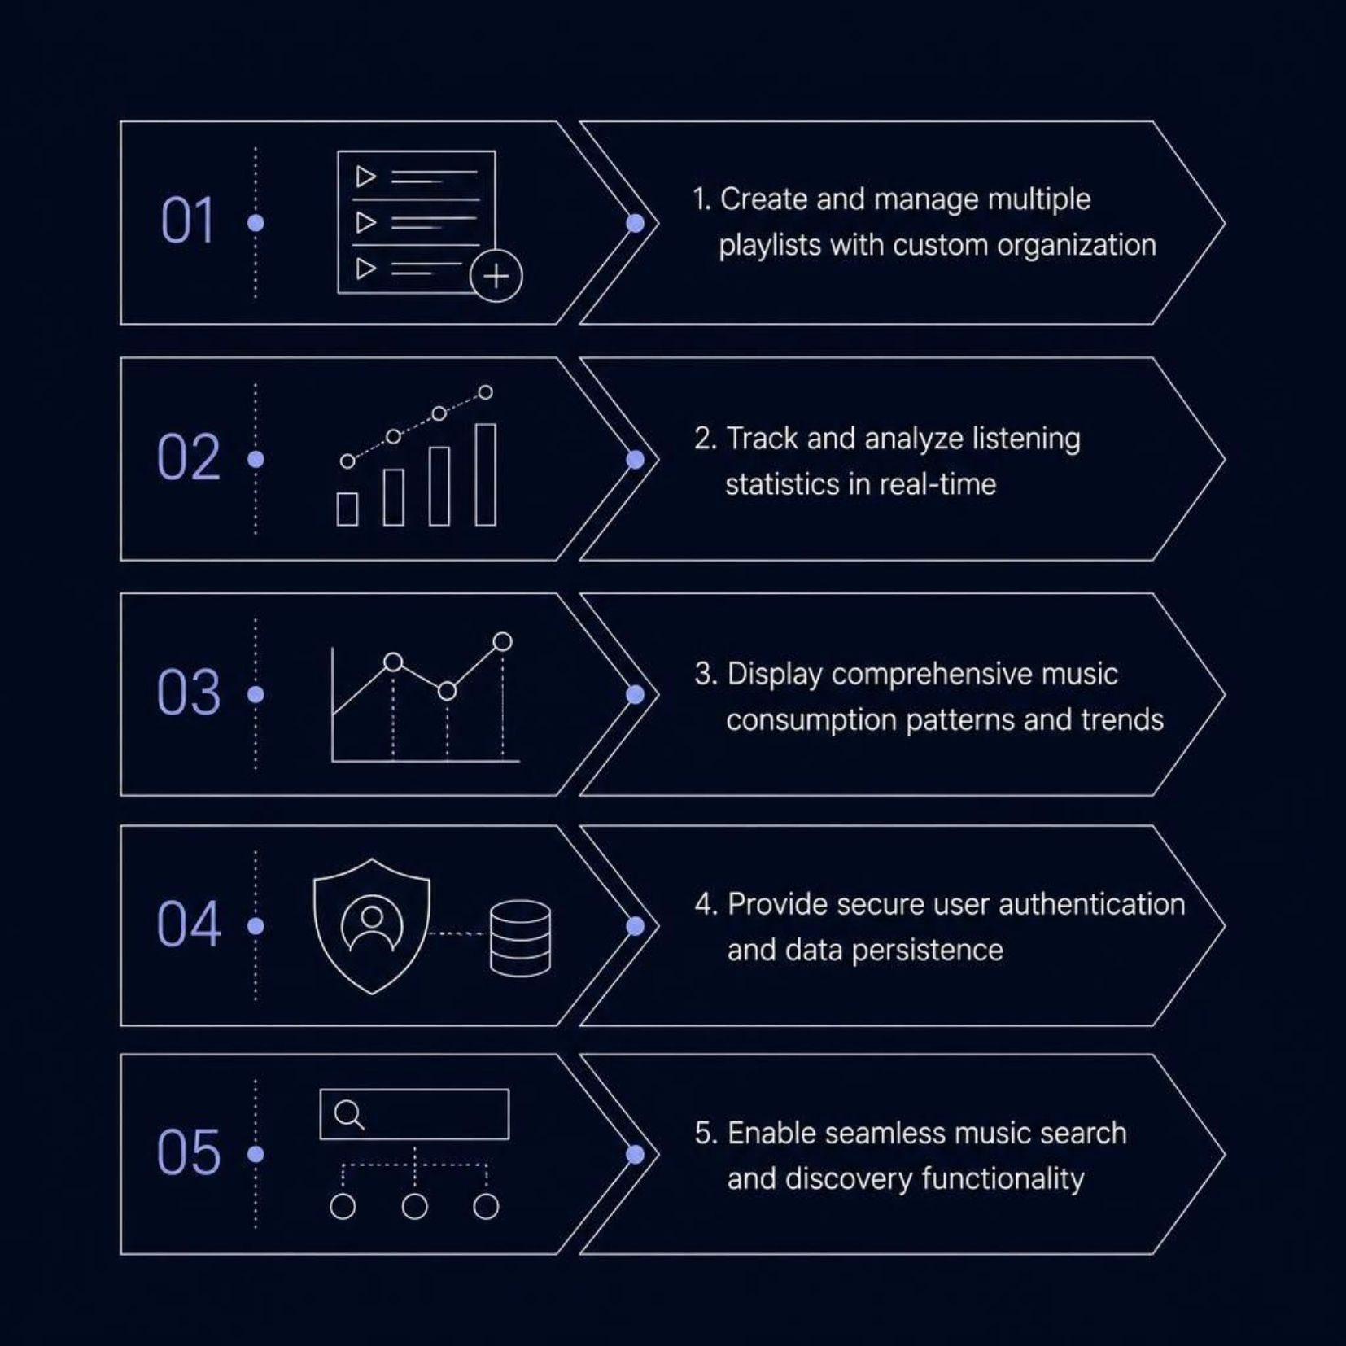
Project Objectives
Primary Goal
Develop a user-friendly platform for playlist management and
music analytics that is accessible, organised, and insightful.
Core Focus Areas
Playlist creation and custom organization
Real-time listening statistics tracking
Music consumption pattern analysis
Secure authentication and data persistence
Music search and discovery functionality

Slide 7
Advantages
User-Centric Design
Real-Time Analytics
Intuitive interface makes playlist management effortless for all users.
Instant insights into listening habits, preferences, and play counts.
Data Visualization
Security
Charts and graphs make statistics easy to interpret at a glance.
Secure authentication protects user data and privacy effectively.
Accessibility
Personalization
Web-based platform accessible across all devices and browsers.
Customizable playlists and preference tracking for every user.

Slide 8

Project Development
Built Entirely in Java
The project was developed using core Java concepts taught during the course, without any external libraries or frameworks.
1
Arrays
2
Methods
Used to store song names, durations, and play counts.
Separate methods handle adding, displaying, and updating songs.
3
Loops & Conditions
4
Switch Statement
Control program flow and handle user input validation.
Powers the interactive menu for navigating features.

Slide 9
Implementation & Demo
A walkthrough of the core features built into the Music Playlist & Listening Stats Manager:
01
02
03
User Registration & Login
Playlist Management
Listening Statistics Dashboard
Secure user registration and login functionality to protect personal data.
Create, edit, and delete playlists — and add or remove songs with ease.
Real-time dashboard tracking play counts, top songs, and listening trends.
04
05
Search & Filter
CRUD Operations
Search and filter music by genre, artist, or title for quick discovery.
Full Create, Read, Update, and Delete operations demonstrated on playlists and user data.

Slide 10

CONCLUSION
To conclude, our Music Playlist and Listening Stats Manager provides a simple and organised way to manage songs and playlists.
It helps users keep track of their listening activity and understand their music preferences. Through this project,
we also applied important Java concepts such as arrays, loops, conditions, switch statements, and methods to a real-world application.
In the future, we can improve the project by adding features like song search, sorting, multiple playlists, favourites and a graphical user interface.
Overall, this project helped us improve our Java programming skills and understand how programming can be used to create useful applications

Slide 11
Future Scope
AI Recommendations
1
Machine learning to suggest songs based on listening patterns.
2
Social Features
Share playlists, collaborate with friends, discover trending music.
Mobile App
3
Native iOS and Android apps for enhanced mobile experience.
4
Streaming Integration
Direct integration with Spotify, Apple Music, and YouTube Music.
Offline Mode & Gamification
5
Download playlists and earn achievements, badges, and leaderboards.

Slide 12

Thank you

